Slide 1

Prediction of Credit Card defaults Using Machine Learning
Programme title
Module: Computer Science & Digital Technologies Project
Student ID: xxxx
Name: Mahesh Adithya

Slide 2
The research aims and objectives
The research main objective is:
to develop a model that would help to ensure to make better decisions to reduce the risks of banks due to credit card defaults.
To obtain the primary aim of this study the following objectives should be achieved:
To understand the factors that influence credit card spending among consumers
To understand the factors that can lead to credit card defaults
To develop a system for the purpose to predict credit card defaults that would help to reduce the risks.
To develop a model with the use of machine learning algorithms that would help the bank to make effective decisions to reduce credit card defaults
To complete the research and the development of the model as per schedule and timeframe and allotted budget.
1

Slide 3
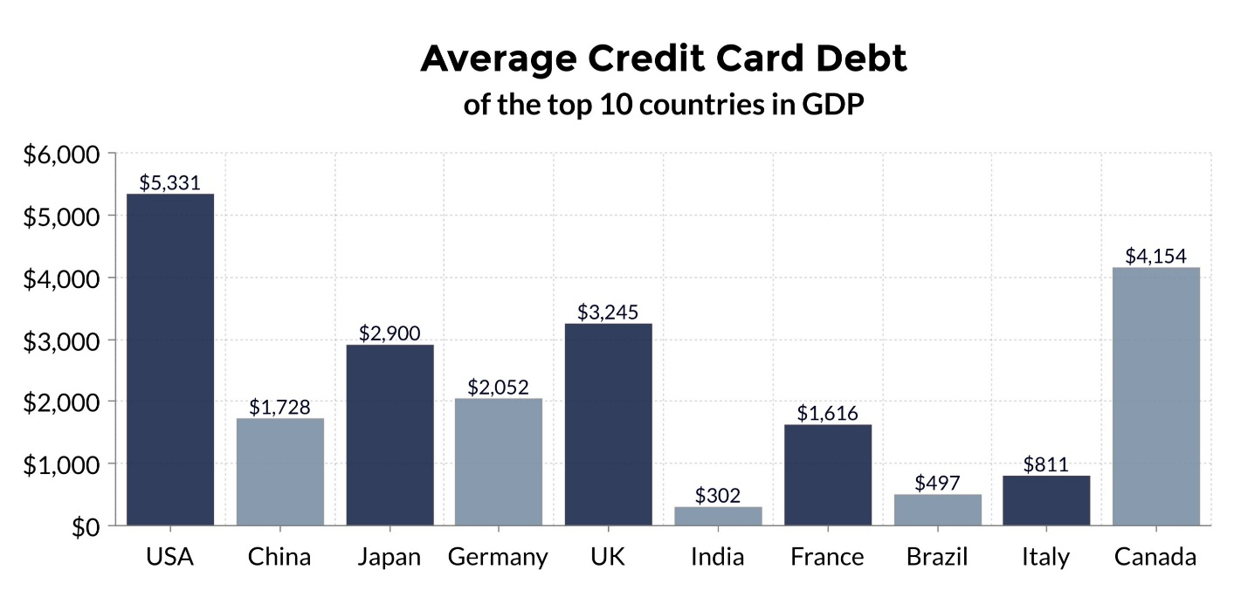
Problem statement
In the era of increased access to credit, it is important towards understanding the consequences to take unsecured consumer debts.
Credit is a limit or a special form of money that is unique, fully convertible or exchangeable with other forms of currency.
In short, credit is both a resource and also a liability that would require future payments to be made with interest. Thus, it is risky and uncertain.
These aspects are a part of the credit card business to carry out with the business of unsecured debts that leads to defaults
Defaults happen when the borrower is not able to make convenient payments, or the consumer misses the payments, dodges or quits to make payments of the credit purchases.
Figure 1: Average Credit Card debts in top 10 countries

Slide 4
Proposed Solution
The banks are required to understand the factors for defaults and can segregate between good customers and bad customers to make an effective decision for the credit card portfolio.
The banks and financial institutions are required to develop a system for the organization to predict the most likely credit card defaults.
The system is towards the development of a credit card risk model that would help to understand the probability of the customers likely to pay back.
The model is to be developed by the use of machine learning algorithms.

Slide 5
Significance of Research
The development of credit card risk model using machine learning algorithms helps to
Analyse and investigate the transaction of the credit card holders, the history of credit and other types of data
Improves the credit card default detection performance over time
The banks and financial institutions can understand the factors for credit card defaults
They can segregate between good customers and bad customers to make an effective decision for the credit card portfolio

Slide 6
Research Methodology
Secondary Research
Conducted literature review to understand the related works of predicting credit card default customers
Data is collected from various data sources including
Journal articles
Published public and private reports
Conference papers
Websources
Implemented Machine Learning Models using
Logistic Regression Algorithm
Decision Tree Algorithm
Support Vector Machines (SVM) algorithm
ML Models are used to
Understand credit card defaults risks
Help banks and financial institutions to make effective decisions

Slide 7
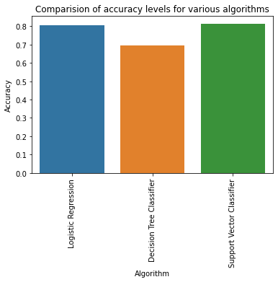
Evaluation
S No | Algorithm | Precision |  | Recall |  | F1-Score
 |  | Not Defaulter | Defaulter | Not Defaulter | Defaulter | Not Defaulter | Defaulter
0 | Logistic Regression | 0.81 | 0.72 | 0.97 | 0.24 | 0.89 | 0.36
1 | Decision Tree Classifier | 0.82 | 0.36 | 0.78 | 0.42 | 0.80 | 0.38
2 | Support Vector Classifier | 0.83 | 0.68 | 0.95 | 0.34 | 0.89 | 0.45
Performance Measures are used for evaluating the developed ML models and Credit Card Defaults Dataset are
Accuracy
Precision
Recall
F1-Score
Cohen Kappa
Matthews Correlation Coefficient
Table 1: Precision, Recall and F1-Score of each algorithm
S No | Algorithm | Accuracy | Loss | Cohen Kappa Score | Matthews corrcoef
0 | Logistic Regression | 0.806333 | 0.193667 | 0.279675 | 0.337337
1 | Decision Tree | 0.696833 | 0.303167 | 0.185353 | 0.186371
2 | Support Vector Classifier | 0.814500 | 0.185500 | 0.357663 | 0.389172
Figure 1: Accuracy Scores of Each Algorithm
Table 2: Credit Card Defaults Prediction Results: Accuracy, Loss, Cohen Kappa, and Matthews Correlation Coefficient

Slide 8
Conclusion & Recommendation
By running various types of algorithms do indicate the use of the support vector machine does provide the best performance among the use of these algorithms.
The use of SVM to provide the best model that helps effective prediction for credit card default.
This is because of the use of support vector machines to provide the best accuracy, precision, recall and f1 score compared with the other algorithms that are used.
The use of the SVM model can help the banks and other financial institutions to help to manage the credit card portfolio and to help to reduce the credit card default risks.

Slide 9
References
Ala’raj, M., Abbod, M. F. & Majdalawieh, M., 2021. Modelling customers credit card behaviour using bidirectional LSTM neural networks. Journal of Big Data, 8(69), pp. 1-27
Chou, T. & Lo, M., 2018. Predicting Credit Card Defaults with Deep Learning and Other Machine Learning Models. International Journal of Computer Theory and Engineering,, 10(4), pp. 105-110.
Han, Y. et al., 2020. Detection and Analysis of Credit Card Application Fraud Using Machine Learning Algorithms. Journal of Physics: Conference Series, Volume 1693.
Khare, A., Khare, A. & Singh, S., 2012. Factors affecting credit card use in India. Asia Pacific Journal of Marketing and Logistics, 24(2), pp. 236-256
Manir, S. P., Saini, A., Sarkar, S. D. & Ahmed, S., 2019. Credit Card Fraud Detection using Machine Learning and Data Science. International Journal of Engineering Research & Technology (IJERT), 8(9), pp. 110-115

